Slide 1
CS 4530
Software Engineering
Lecture 4 - Software Architecture
Jonathan Bell, John Boyland, Mitch Wand
Khoury College of Computer Sciences

Slide 2
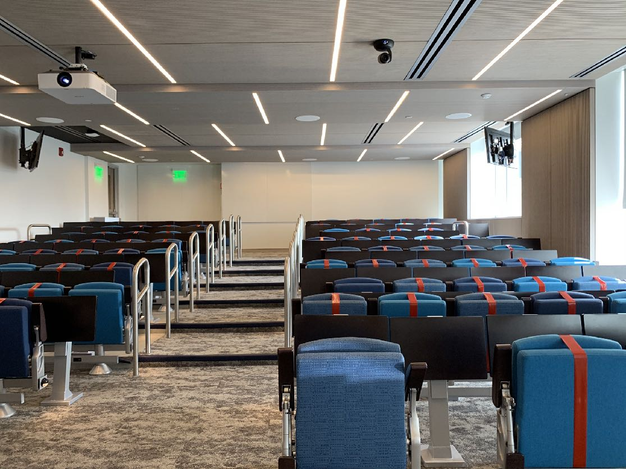
Zoom Mechanics
Recording: This meeting is being recorded
If you feel comfortable having your camera on, please do so! If not: a photo?
I can see the zoom chat while lecturing, slack while you’re in breakout rooms
If you have a question or comment, please either:
“Raise hand” - I will call on you
Write “Q: <my question>” in chat - I will answer your question, and might mention your name and ask you a follow-up to make sure your question is addressed
Write “SQ: <my question>” in chat - I will answer your question, and not mention your name or expect you to respond verbally

Slide 3
Today’s Agenda
Administrative:
HW1 Discussion, due THIS Friday
Please watch all 4 lesson videos for Thursday
Today’s lecture:
Poll
Overview of 4 software architectures and 4 software quality attributes
Real-world system architectures

Slide 4
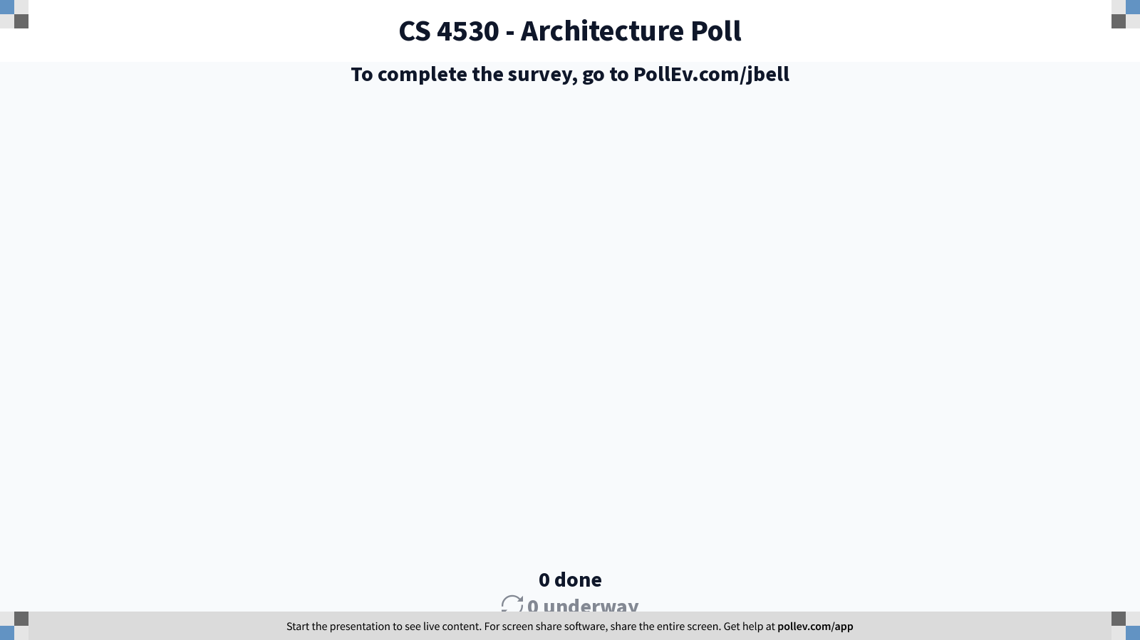
Notes:
CS 4530 - Architecture Poll
https://www.polleverywhere.com/surveys/UChFdQWO2hIkWMdP7ViXx

Slide 5
Focus for this week: zoom out
Metaphor: building architecture

Slide 6
Focus for this week: zoom out
How do the pieces fit together? What do we reuse?

Slide 7
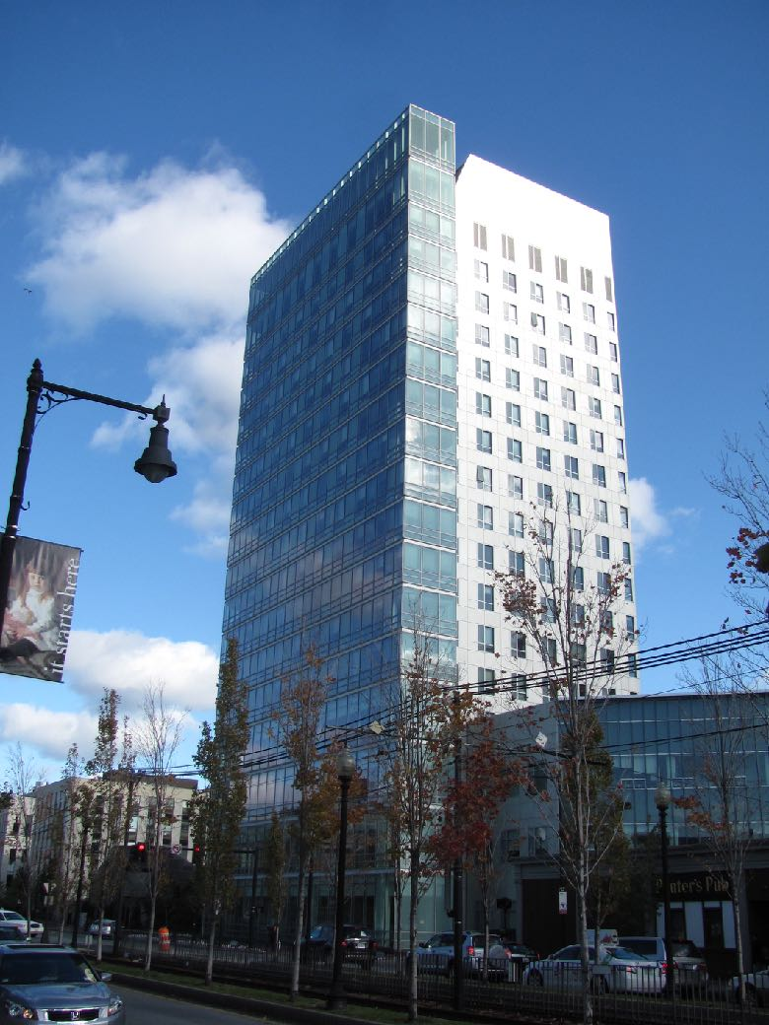

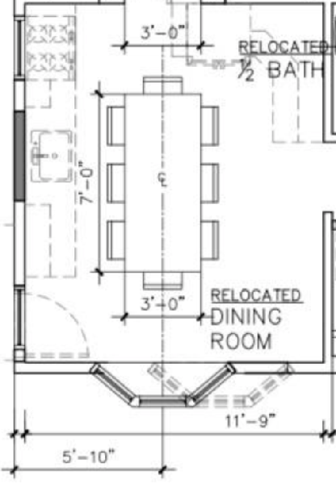
Focus for this week: zoom out
Architectural Patterns
Notes:
Last week we talked about software patterns in the small, which might be EQ to the kinds of architectural patterns for laying out a dining room: arrange the table to be centered to the window, put a cut-through at the center of the wall that lets you see into another space, perhaps because this room would feel cramped otherwise, etc. That was design in the small. Now, let’s think about the actual architectural patterns that make this a cohesive space. The greens, the arrangement of the buildings to have mostly southern exposures, the clustering of administrative, academic, and residential spaces. The arrangement of athletics off to the side.

Slide 8
Choose wisely
Architecture can make a HUGE difference in quality attributes like…
Performance
Reliability
Scalability
Cost
Plus many more quality attributes, see Lesson 3.1

Slide 9
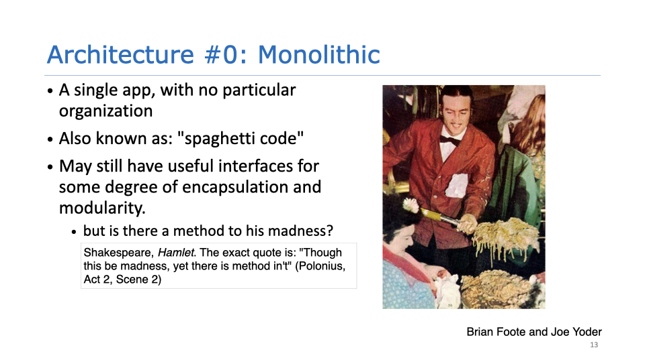
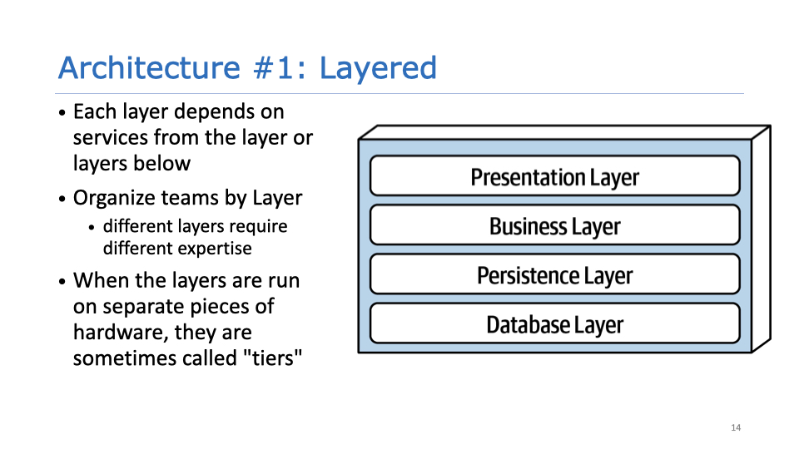
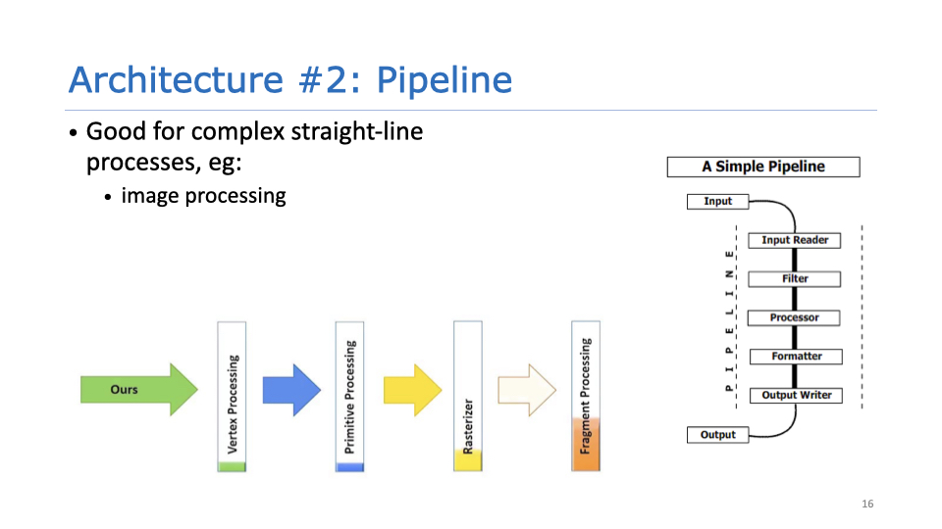
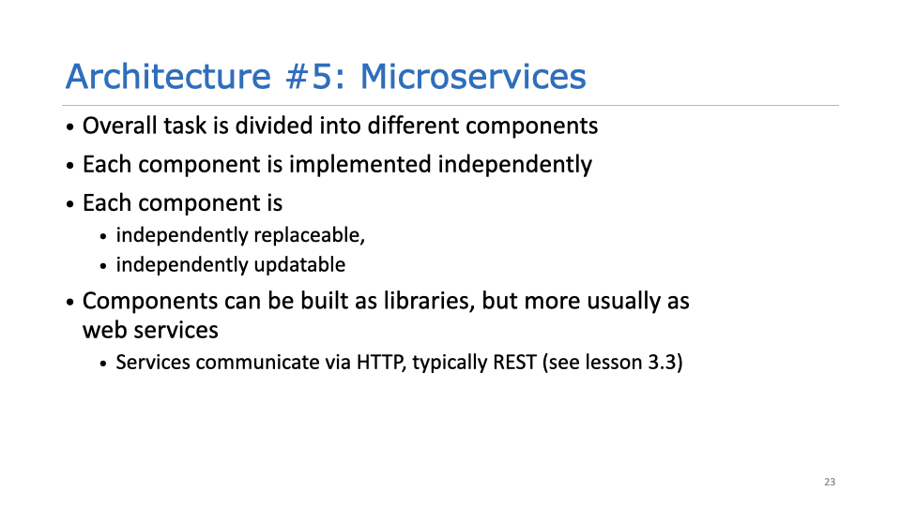
Notes:
Also: #3 microkernel, #4 event-driven. We’ll see more examples of those on Thursday. Today examples are these.

Slide 10
Networks as Abstractions
CS 3700, Summarized to a Slide
A network consists of communication links. Ideally: “Stuff goes in, stuff comes out”
Networks have several “interesting” properties we will look at
Latency
Failure modes
Machine 1
Machine 2
Notes:
Stuff goes in, stuff goes out?
Not a perfect abstraction, because:
Speed of light (1 foot/nanosecond)
Communication links exist in uncontrolled/hostile environments
Communication links may be bandwidth limited (tough to reach even 100MB/sec)
In contrast to a single computer, where:
Distances are measured in mm, not feet
Physical concerns can be addressed all at once
Bandwidth is plentiful (easily GB/sec)

Slide 11
Designing for Performance Metrics
What factors can impact performance?
Limits imposed by physics
Limits imposed by technology
Limits imposed by economics
These limits can force us to make tradeoffs
Smaller chips are faster, but harder to dissipate heat
Need to serve X clients, can only spend Y on CPUs

Slide 12
Designing for Performance: Metrics
Latency in a pipeline architecture
Time between client sending request and receiving response
What contributes to latency?
Latency sending the message
Latency processing the message
Latency sending the response
Adding pipelined components -> latency is cumulative
Camera
Sends images
Image Service
Phase 1
Phase 2
10ns
5ns
5ns
10ns
Total latency: 30ns
Processes images

Slide 13
Designing for Performance: Metrics
Throughput in a pipeline architecture
Measure of the rate of useful work done for a given workload
Example:
Throughput is camera frames processed/second
When adding multiple pipelined components -> throughput is the minimum value
Camera
1000 fps
Image Service
Sends images
Phase 1
Phase 2
Total throughput: 10fps
10fps
29fps
1000 fps
Processes images

Slide 14
Designing for Performance: Metrics
Latency (In general)
Often more challenging to improve than increasing throughput
Examples:
Physical - Speed of light (network transmissions over long distances)
Algorithmic - Looking up an item in a hash table is limited by hash function
Economic - Adding more RAM gets expensive

Slide 15


Designing for Performance: Case Study
Stock Trading
Buy low/sell high
Most of skill is in knowing what a stock will do before your competitors

Slide 16

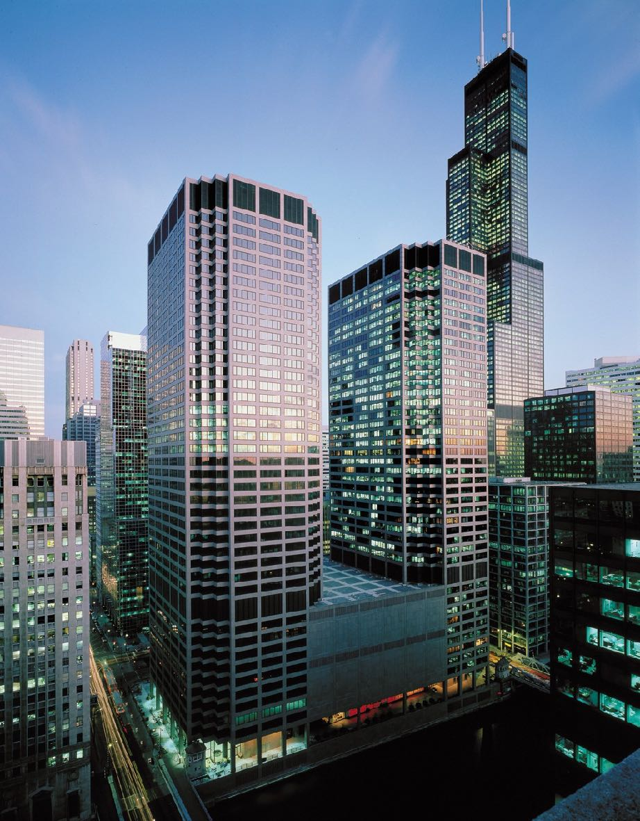


Designing for Performance: Case Study
Algorithmic Trading
~700 miles
Round trip: ~14 msec @ speed of light
3Ghz CPU would process ~22m instructions in this time!
Equinix NY5 Data Center, Secaucus NJ
CME Data Center, Aurora, IL
Chicago Mercantile Exchange, Chicago, IL
NY Stock Exchange, New York, NY
Photos:
CME Building: By CME Group/Henry Delforn/Allan Schoenberg - CME Group, CC BY-SA 3.0
NYSE Building: By Jeffrey Zeldman, CC BY 2.0
CME data center: by CME Group
NY5 data center: by Equinix Inc
Notes:
People actually care a LOT about the latency between NYC and Chicago, because commodities are traded in Chicago and stocks are traded in NYC
Changes to commodities prices (e.g. ethanol) can dramatically impact price of some stocks.
Note not really Chicago or NYC, data centers are 10-15 miles outside of city where land is cheaper. Secaucus NJ and Aurora IL
It’s not quite as simple as 700 miles -> 7.4msec
There are streams, mountains, etc… more like 1,000 miles
Light is refracted in a fiber optic cable is ~31% slower
What do we do if money is no object?

Slide 17
Designing for Performance: Case Study
Or: Reducing Latency with Billions of Dollars
Graphics: https://www.zerohedge.com/news/chicago-new-york-and-back-85-milliseconds
Notes:
Red - original cable. Spread networks (green) came in and blew up mountains to go straight through the Allegheny range, cutting off almost 200 miles. Made obsolete just years later by the microwave businesses. Orange was microwave, blue is new microwave.

Slide 18
Software Architectures to Reduce Latency
Pipeline architecture
Facebook.com
Request
Cache Check
Build friends list
Build Newsfeed
Build Suggestions
Send response
Response

Slide 19
Software Architectures to Reduce Latency
Pipeline architecture
Approach: Optimize for the common case (aka fast path and slow path)
Facebook.com
Slow path
Build friends list
Build Newsfeed
Build Suggestions
Request
Cache Check
Send response
Response
Serve from cache
Fast path

Slide 20
Software Architectures to Reduce Latency
Pipeline architecture
Approach: use concurrency
Limited by serial section
Slow path
Facebook.com
Build friends list
Build Newsfeed
Build Suggestions
Send response
Response
Request
Cache Check
Fast path
Serve from cache

Slide 21
Software Architectures to Improve Throughput
Pipeline architecture
Introduce concurrency into our pipeline
Each stage runs in its own thread (or many threads, perhaps)
If a stage completes its task, it can start processing the next request right away
E.g. our system will process multiple requests at the same time
Request
Facebook.com
Response
Cache Check
Build friends list
Build Newsfeed
Build Suggestions
Send response

Slide 22
Software Architectures to Improve Throughput
Pipeline architecture
Can also introduce concurrency to stages
If one stage is a bottleneck, can we add more copies of it? (Hooray for micro services!)
Request
Facebook.com
Response
Cache Check
Build friends list
Build Newsfeed
Build Suggestions
Send response
Build Newsfeed
Build Newsfeed

Slide 23
Software Architectures to Improve Throughput
Solving Overload with Queueing and Buffering
What happens when a slow component gets overloaded?
Need to place a bounded buffer in between components!
When buffer becomes full, it prevents new requests from being accepted
Request
Facebook.com
Response
Cache Check
Build friends list
Build Newsfeed
Build Suggestions
Send response
Buffer
Build Newsfeed
Build Newsfeed

Slide 24
Architecture Case Study: Distributed File Systems
Goals
Shared filesystem that will look the same as a local filesystem
Scale to many TB’s of data/many users
Fault tolerance
Performance

Slide 25
NFS: The Networked Filesystem
Architecture: Monolithic Server
Client
Server
Server
Server holds all files
open(“file”)
fd
seek(fd, 10)
read(fd)
Client
Client
Client
Client
Client
Clients send every read/write request to server
Notes:
NFS’ approach:
Server serializes all accesses, performs them, and sends back result.
Great: Same behavior as if both programs were running on the same local filesystem!
Question: How does it scale?
Bad: Performance can stink. High latency to make each request to server. (Read/write KB at a time).
Limited by server’s IO bandwidth, amount of storage you can attach
Question: Is it reliable?

Slide 26

NFS: The Networked Filesystem
Not quite a monolithic architecture: caching
Client 1 cache
Client 2 cache
File 1: “b”
File 1: “b”
1. Open File
3. Open File
2. Read File: “a”
4. Write File: “b”
Server
7. Close File
File 1: “b”
File 1: “a”
File 1: “a”
File 1: “a”
Client 3 cache
Client 4 cache
8. Open File
5. Open File
9. Read File: “b”
6. Read File: “a”
This is called “Open-to-Close” consistency. It is weird.

Slide 27
Sidebar: Cache Consistency
“The biggest problem in computer science”
Strawman: Before you do a read, ask the server if the file has changed. Before you acknowledge a write, make server confirm the write
This works, but it’s a lot of network messages, and what happens when the network is slow or fails?
This is a fundamental problem in distributed systems: when data is replicated, choose between “fast” or “safe” (a gross simplification of the CAP theorem)

Slide 28

NFS: The Networked Filesystem
What do we think of the monolithic architecture?
Server
Server holds all files
Client
Client
Client
Client
Client
All files stored on the same server is bad because:
Fault tolerance (what if it crashes?)
Performance (what if we need to access 100’s of GBs at a time?)
Scale (what if we need to store PBs of files?)
Plus, NFS’ open-to-close caching can be weird
Clients send every read/write request to server
Notes:
NFS’ approach:
Server serializes all accesses, performs them, and sends back result.
Great: Same behavior as if both programs were running on the same local filesystem!
Bad: Performance can stink. Latency of access to remote server often much higher than to local memory

Slide 29
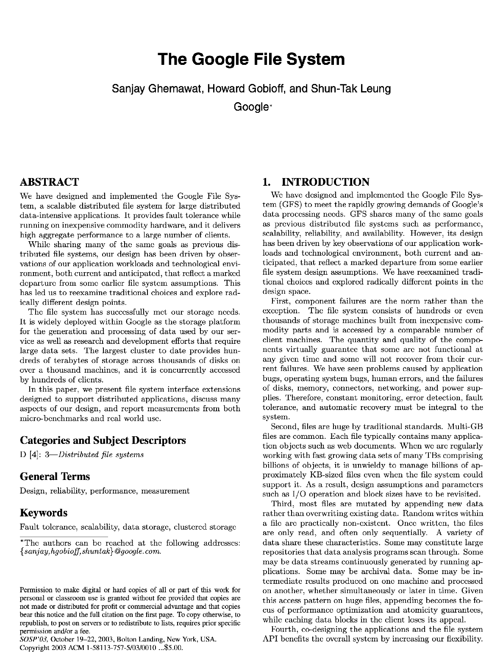
GFS: Google File System
Design Goals
“High sustained bandwidth is more important than low latency. Most of our target applications place a premium on processing data in bulk at a high rate, while few have stringent response time requirements for an individual read or write.”
Notes:
Motivation: OK, so NFS is reading/writing who knows, 300MByte/sec. How do I do 900MByte/sec?
Question: What parts of the NFS picture relate to bandwidth? Answer: Single NFS server constrains bandwidth to single-device I/O speeds. Can’t add more servers, because then have this replication problem
Question: How can we trade latency for bandwidth?
Answer: What if we had one special server that knew which servers knew about which files, then split up the files? Pay extra in terms of latency (more requests), but can scale bandwidth. It’s a solution that makes tiers of servers.
Key insight: don’t provide same abstractions as filesystem. Not a POSIX interface, throw away the regular file system client, now use our own client, focus on appending to end of files, big streaming reads

Slide 30
GFS: Google File System
Big idea: Give up the old notion of a filesystem
GFS does not look like a “regular” filesystem
Google apps observed to have specific R/W patterns (usually read recent data, lots of data, append to end of file instead of overwriting middle)
NFS tried to implement the same interface as a non-network filesystem. Why?

Slide 31
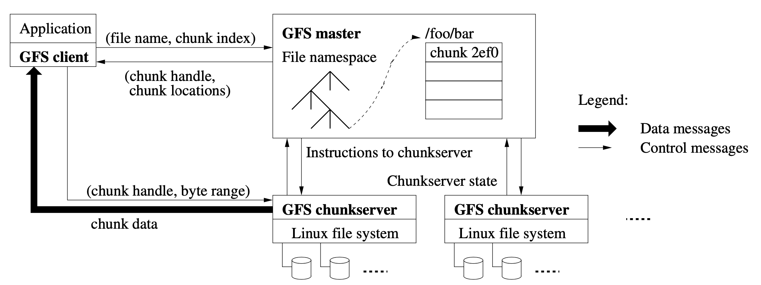
GFS: Google File System
Tiered Architecture: GFS Client, GFS Master, GFS Chunkservers
Figure: “The Google File System” by Sanjay Ghemawat, Howard Gobioff, and Shun-Tak Leung, SOSP 2003
Notes:
Single master server (can replicate to a backup too)
Holds all metadata (in RAM!) - namespace, ACL, file-chunk mapping
In charge of migrating chunks, GC’ing chunks
Data stored in 64MB chunks each with some ID
Compare to EXT-4’s 4KB block
Thousands of chunk servers
Chunks are replicated
Chunk servers don’t cache anything in RAM, store chunks as regular files

Slide 32
GFS: Google File System
Key architectural components
Servers:
Single metadata server
Multiple data servers (“chunk servers”)
Base unit is a “Chunk”
Fixed-part of a file (typically 64MB)
Read/write: specify chunk ID + byte range into file
Each chunk is replicated to at least 3 servers

Slide 33
GFS: Google File System
Tiered Architecture: What are the tiers?
GFS Client
GFS Master
ChunkServer
ChunkServer
ChunkServer
ChunkServer
ChunkServer
ChunkServer
ChunkServer
ChunkServer
ChunkServer
ChunkServer
ChunkServer
ChunkServer
ChunkServer
ChunkServer
ChunkServer
ChunkServer
ChunkServer
ChunkServer
ChunkServer
ChunkServer
ChunkServer
ChunkServer
ChunkServer
ChunkServer

Slide 34
GFS: Google File System
Tiered Architecture: Reading Files
GFS Client
Where is file f?
GFS Master
List of chunks and their locations
Reads chunks
ChunkServer
ChunkServer
ChunkServer
ChunkServer
ChunkServer
ChunkServer
ChunkServer
ChunkServer
ChunkServer
ChunkServer
ChunkServer
ChunkServer
ChunkServer
ChunkServer
ChunkServer
ChunkServer
ChunkServer
ChunkServer
ChunkServer
ChunkServer
ChunkServer
ChunkServer
ChunkServer
ChunkServer
Notes:
[Draw examples showing other clients, high throughput. Note still have latency of requests to master]

Slide 35
GFS: Google File System
Analyzing the architecture for quality attributes
Scalability: Lots of big files? Just add more chunk servers
Bad: Chokes up if workload is lots of small files (too much metadata!)
Performance: Throughput scales linearly with number of chunk servers
Reliability:
Chunks are replicated
Cost: Chunk servers are cheap machines with cheap disks
Figure: “The Google File System” by Sanjay Ghemawat, Howard Gobioff, and Shun-Tak Leung, SOSP 2003
Notes:
Single master server (can replicate to a backup too)
Holds all metadata (in RAM!) - namespace, ACL, file-chunk mapping
In charge of migrating chunks, GC’ing chunks
Data stored in 64MB chunks each with some ID
Compare to EXT-4’s 4KB block
Thousands of chunk servers
Chunks are replicated
Chunk servers don’t cache anything in RAM, store chunks as regular files

Slide 36
Comparing GFS + NFS
NFS: Monolithic Server, GFS: Tiered Metadata + Chunk Servers
Fault tolerance (what if it crashes?)
NFS: Crashing the server is bad
GFS: Crashing a chunk server is fine, crashing the primary is bad
Performance (what if we need to access 100’s of GBs at a time?)
NFS: Limited by single server’s bandwidth
GFS: Limited only by number of chunk servers (can get good parallelism between 100 chunk servers each at 1GB/sec)
Scale (what if we need to store PBs of files?)
NFS: Limited by storage of single server
GFS: Limited by amount of metadata that can be stored on single master
Plus, NFS’ open-to-close caching can be weird
GFS: No caching

Slide 37
Comparing GFS + NFS
NFS: Monolithic Server, GFS: Tiered Metadata + Chunk Servers
NFS: All requests handled by a single server
GFS: All metadata requests handled by a single metadata server, all reads/writes handled by chunk servers
Which is better?
Performance?
Reliability/Safety?
Portability?
Supportability?
Scalability?
Cost?
Notes:
The answer is that it’s really not possible to say which is better generically: it depends on how much you need to scale, and what your reliability requirements really are.

Slide 38
Now that you’ve seen it once
Hadoop (Open source Map/Reduce implementation)
HDFS NameNode
HDFS client
HDFS DataNode
HDFS DataNode
Figure: “The Google File System” by Sanjay Ghemawat, Howard Gobioff, and Shun-Tak Leung, SOSP 2003

Slide 39
Discussion/Activity: Performance Bottlenecks
What is a piece of software that you’ve written or worked with that faced a performance challenge, and how did you and/or your team overcome it?
Notes:
My example: Covey.Town presence updates

Slide 40
This work is licensed under a Creative Commons Attribution-ShareAlike license
This work is licensed under the Creative Commons Attribution-ShareAlike 4.0 International License. To view a copy of this license, visit http://creativecommons.org/licenses/by-sa/4.0/
You are free to:
Share — copy and redistribute the material in any medium or format
Adapt — remix, transform, and build upon the material
for any purpose, even commercially.
Under the following terms:
Attribution — You must give appropriate credit, provide a link to the license, and indicate if changes were made. You may do so in any reasonable manner, but not in any way that suggests the licensor endorses you or your use.
ShareAlike — If you remix, transform, or build upon the material, you must distribute your contributions under the same license as the original.
No additional restrictions — You may not apply legal terms or technological measures that legally restrict others from doing anything the license permits.

